Slide 1
Supporting Physical and Social Science Integration: Storm Surge
Jennifer Sprague
National Weather Service
National Oceanic and Atmospheric Administration

Slide 2
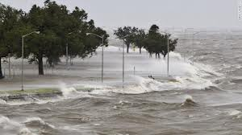
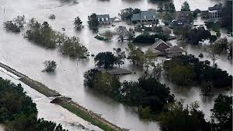
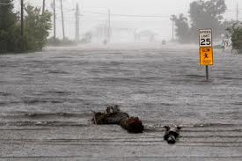
The Communication Quandary
Storm Surge – The threat is complex and difficult to communicate!

Slide 3
HFIP Socio-Economic Working Group
HFIP Socio-Economic Working Group
Co-Lead by NHC Director Rick Knabb & Jennifer Sprague
Members:
NHC: Edward Rappaport, Jamie Rhome & Robbie Berg
NWS WFOs: Lance Wood (WFO Texas), Hendricus Lofus (WFO CT)
FEMA: Matthew Green (FEMA Liaison at NHC)
State/Local Emergency Managers: Chuck Lanza (FL), Mike Sprayberry (NC), Christopher Moore (TX),
Social Scientist: Hugh Gladwin
Media: Vacant
Private Sector: Karen Townsend (HURREVAC)

Slide 4
Surge Social Science Strategy
NOS/CSP
Assess Public Need
Phase 1 (TC) and Phase 2 (ET)
Lazo & Morrow: interviews, focus groups, public surveys
NOS/CSP & CSDL
Assess Partner Needs
Phase 3
Lazo & Morrow: media web interviews and online survey
NWS/OST
Decision Support for EMs
WxEM – Tropical use case in NC
RENCI, UNC-CH, ECU: multiple methods to assess EMs
NWS/HFIP
Product Prototyping and Evaluation
Phase 4 (TC): Inundation graphic, Storm Surge watch/warning
ERG: prototype evaluations via interviews, focus groups, public surveys
Irene Service Assessment
UCAR Community Advisory Committee
NWS/NCEP
Experimental Products
2013-2015 season
Inundation graphic, storm surge watch/warning
NOS/CSC
Marketing and Outreach
Integrating new products
NWS/NCEP
Operational Products
2014-2016 season
Inundation graphic, storm surge watch/warning

Slide 5
Assessing Current Storm Surge Information People’s Understanding of Hazard & Partner Needs
Phase 1: Tropical
Results show people do not understand surge or its risk, and want some type of further information
Phase 2: Extratropical
Uses EM interviews, focus groups, online survey
Phase 3: Partner needs
Focuses on broadcast meteorologists’ perceived needs, constraints, and possibilities for new/additional storm surge information

Slide 6
WxEM: Decision Support for Emergency Managers (EMs)
EMs desire a locally relevant inundation graphic
EMs prefer a range of scenarios versus probability plots
EMs desire surge predictions earlier (i.e., 72 hrs or more before TC landfall)
Modeling enhancement needed

Slide 7
Product Prototyping & Evaluation
NHC hired GIS expert to develop inundation graphic prototypes
Social scientists are evaluating prototypes
Interviews, focus groups, surveys of EMs and public
Prototypes included in broadcast met survey from partner needs project
Public survey imminent

Slide 8
Cartographic of Inundation Graphics
Small project to apply and evaluate cartographic techniques to inundation graphics
Advice on appearance and color scheme
Survey of coastal residents
Eye-tracking analysis of prototype graphics provided by NHC
Results showed preference for an inundation graphic with a range of colors and a scale of descriptive words (low, med, hi, extreme)

Slide 9
FY12 – Storm Surge Marketing Plan
CSC leading effort via IDIQ contract process
Develop a marketing plan for NHC and WFO meteorologists to help EMs and broadcast mets accurately explain storm surge risk to their audiences
Understand how information flows between NHC/WFOs and EMs and broadcast meteorologists, and their target audiences, and the roles of each in risk communication
Develop marketing plan for NWS and its downstream audiences

Slide 10
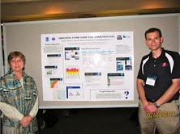
Success Story
Physical & Social Science Integration
Holistic Approach
Wide Collaboration Across NOAA

